Slide 1
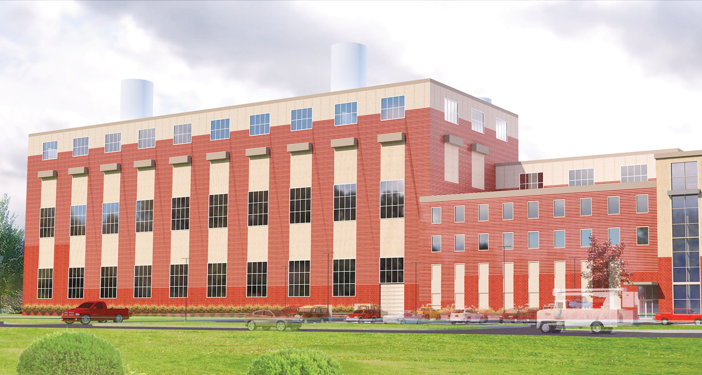
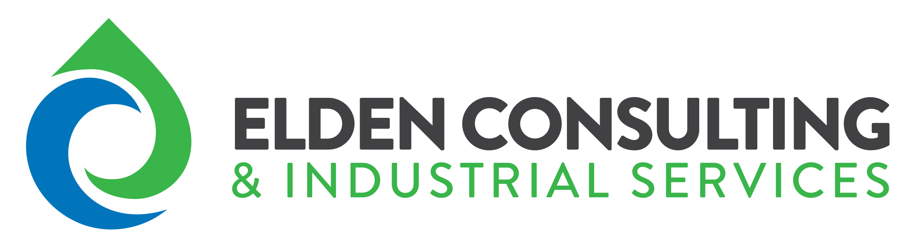
Delta Energy Project
Lansing, Michigan

Slide 2
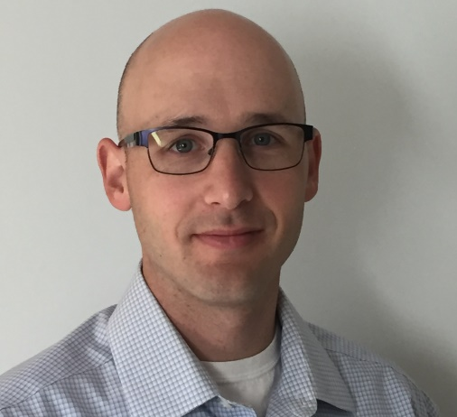
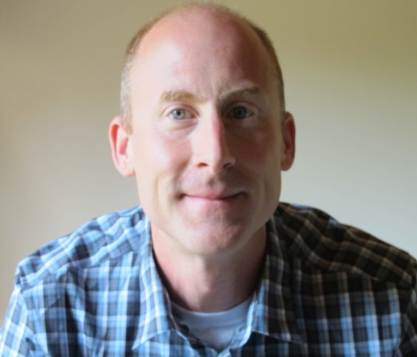
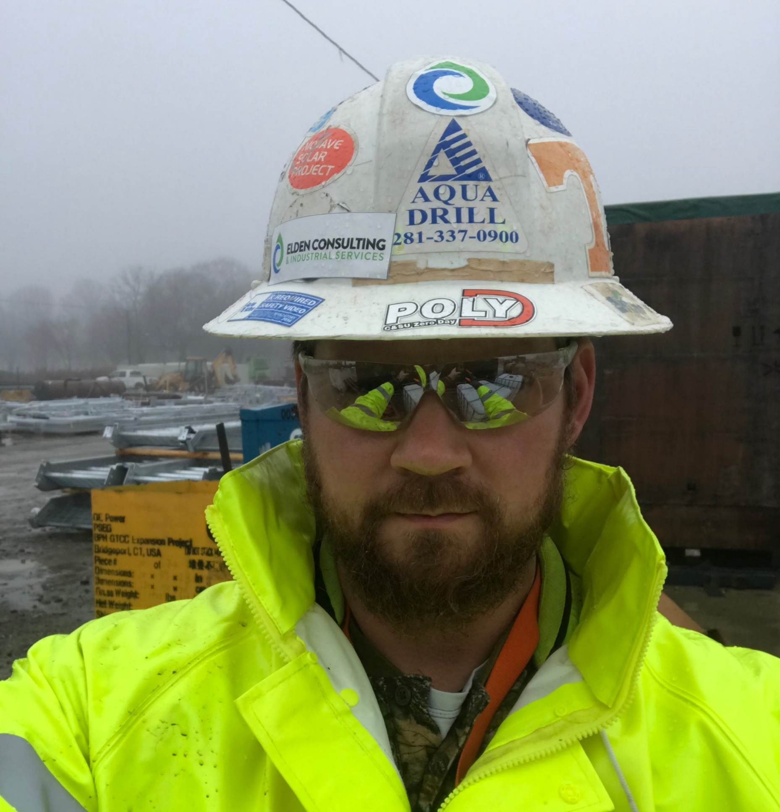
Delta Energy Project Team
Below will be the team designated for the Delta Energy Project. Collectively the team has 35+ years and over 100 projects in the industrial cleaning and pre-commissioning industry. The experience of the team is diverse in Engineering, Technical Application and Onsite Project Management
Keith Stanisewski, PE
Alex
Holmes
Matthew
Catron
15 years of engineering process design and solutions.
Engineering QA/QC oversight
Global management of pre-commissioning projects and personnel
Managed over 30 large scale pre-commissioning services
Commissioned over 12GW of power
Commercial responsibility of $16M annual gross
Steam blow expert (closed and open cycle)
15 years of industrial service and fluid processes
5 years as a project manager
Manager or supervisor in over 25 large scale projects world-wide (greater than $500K)
Commissioned a total of 9GW of power
Leadership of teams up to 20 project site personnel
Responsibility of $3M global company assets
12 years of industrial service field work
10 years of project management
Expertise in
  Lube oil flushing
  Chemical cleaning
  Mechanical flushing
  Steam blowing
  Air blowing
Experienced leader and manager
Licensed Professional Engineer – State of Maine
Bachelor of Science, Civil Engineering; University of New Hampshire
OSHA 30
Licensed EMT
Certified NH Firefighter (HAZWOPR)
Bachelor of Science, Geology;
Vanderbilt
OSHA 30
United States Marine – Sargent
OSHA 10
Deputy Sheriff in TN

Slide 3
WHO WE ARE
Adapt to Project
Elden Consulting & Industrial Services (Elden) is an experienced pre- commissioning service company that provides pre-commissioning and maintenance services for the power and CHP industry:
Engineering and Consulting
Experienced Onsite Supervisors and Technicians
Equipment Rental
12 years in the pre-commissioning industry A combined total of 48 large scale, global pre-commissioning projects
Combined 20.2GW of power commissioned

Slide 4
EXPERIENCE
Elden Leadership
Elden Consulting & Industrial Services (Elden) is an experienced pre- commissioning service company that provides pre-commissioning and maintenance services for the power and CHP industry:
12 years in the pre-commissioning industry A combined total of 48 large scale, global pre-commissioning projects throughout their careers
Combined 21.2GW of power commissioned
Professional Engineer – Licensed in Maine

Slide 5





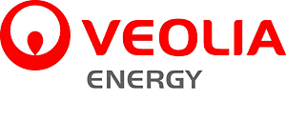
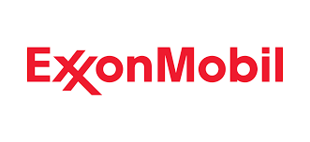

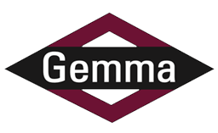
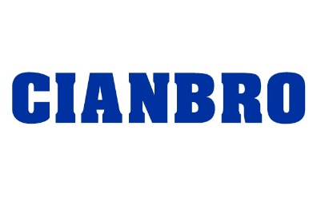
OUR CLIENTS

Slide 6
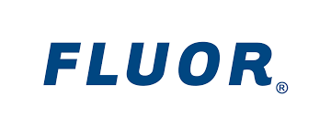


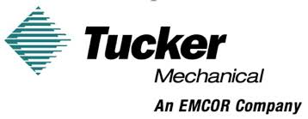

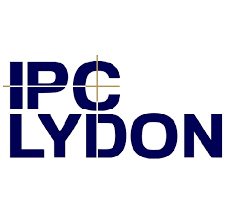


OUR CLIENTS

Slide 7

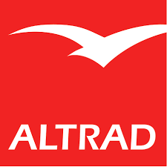

OUR CLIENTS - Consulting

Slide 8
PROJECT SCOPE
Lansing BWL Request
Safety: Engineer and execute the work safely with the correct equipment and materials designed for the process system
Cost: provide a cost-effective solution for the pre-commissioning of the complete plant cycle
  Cost for execution
  Cost for craft support
  Cost for utilities
Time: proposed solutions should reduce the commissioning time in relation with the cost
Compliance: remain in compliance with BWL, BartonMalow and OEM specifications

Slide 9
PROPOSED SERVICES
Lube Oil Flushing
High velocity flushing with pumps and filtration
Systems to be flushed:
  Siemens SGT800 (total of 3)
    Bearing lube oil
    Jacking oil
  Doosan Steam Turbine (total of 1)
    Bearing lube oil
    Seal oil
    Control oil

Slide 10
LUBE OIL FLUSHING
Lube Oil Flushing
Cost/Time Reduction
  Flushing pump has been oversized to increase oil velocities throughout the system at an estimated 12-14 fps compared to approximately 6 fps for normal operation
  Extensive filtration
    Filtration at multiple points in the system
      All bearing jumpers
      Main discharge on the pump
      Jacking oil
  Vibration on pipes at strategic locations
  Kidney loop polishing with heater
  Nitrogen as an option

Slide 11
PROPOSED SERVICES
Turbulent Aerated Pig (TAP) Flushing
Systems Applied To:
  Closed Cooling Water
  Fuel Gas
  Condensate
  Feed water
Optional:
  Demineralized Water

Slide 12
PROPOSED SERVICES
Turbulent Aerated Pig (TAP) Flushing
Mechanical flushing of pipe system with aerated water and motive air
ANSI certified stainless-steel pressure vessels
Process wetted equipment are light-weight stainless
150lb rated materials
Quick connect fittings

Slide 13
PROPOSED SERVICES
Turbulent Aerated Pig (TAP) Flushing
Reduction of flanges and bolting equates to a reduction of cost
Table showing the cost saving with the SS quick connect flanges and trailer vs BEST, ICCI and B&W’s conventional flush and air blow
Process | Craft Manpower Required | Manpower Rate per hour | Hours | Crane Needed | Tele-lift Needed | Manpower Cost
Coventional circulation | 8 | $ 160.00 | 5000 | Yes | Yes | $ 800,000.00
Competior's Froth/Hydro Flushing Process | 6 | $ 160.00 | 4000 | Yes | Yes | $ 640,000.00
Elden TAP Flush | 6 | $ 160.00 | 2000 | No | No | $ 320,000.00

Slide 14
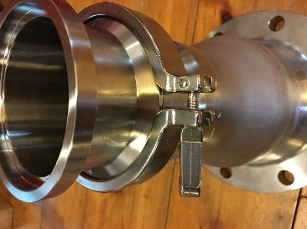
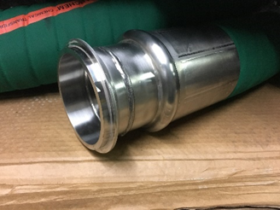
T.A.P. Flush
(Turbulent Aerated Pig)
TAP Flushing utilizes a formed air and water mixture passed through the pipe system at high a velocity to remove loose mechanical debris, internal water-soluble coatings, loosely adhered welding slag, corrosion deposits and other foreign contaminants from the pipe surfaces.
TAP Flush™ is chemical free and an effective replacement for conventional mechanical pigging and air blowing of piping systems. However, chemicals can be added to enhance the cleaning operation (e.g. degreasing agent) to achieve the desired result. The flush is performed by generating a pig of water that has been entrained with air to achieve a pig density that is nearly 30% that of water. This aerated water pig is displaced through the piping system at velocities of 20 to 30 feet per second.
Apply to the Following Systems:
O&G Petrochem process systems
Cooling water
Fuel oil/Fuel Gas
Lube oil
Boiler systems

Slide 15
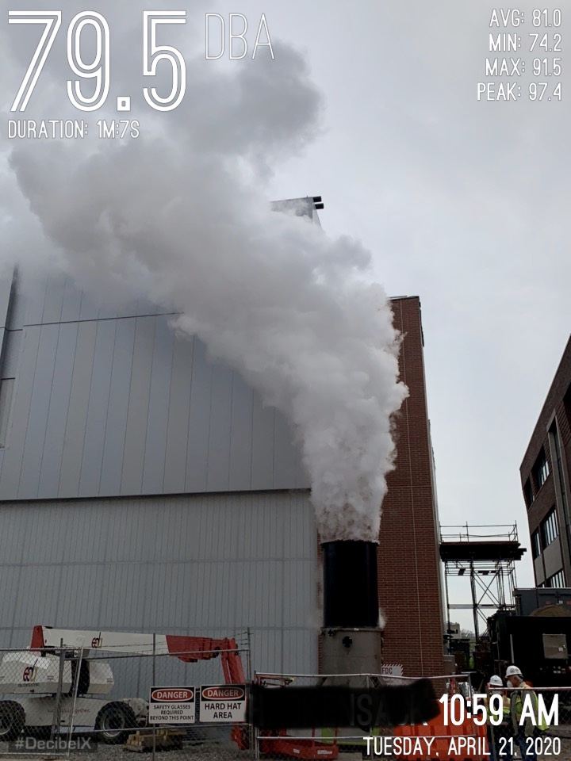
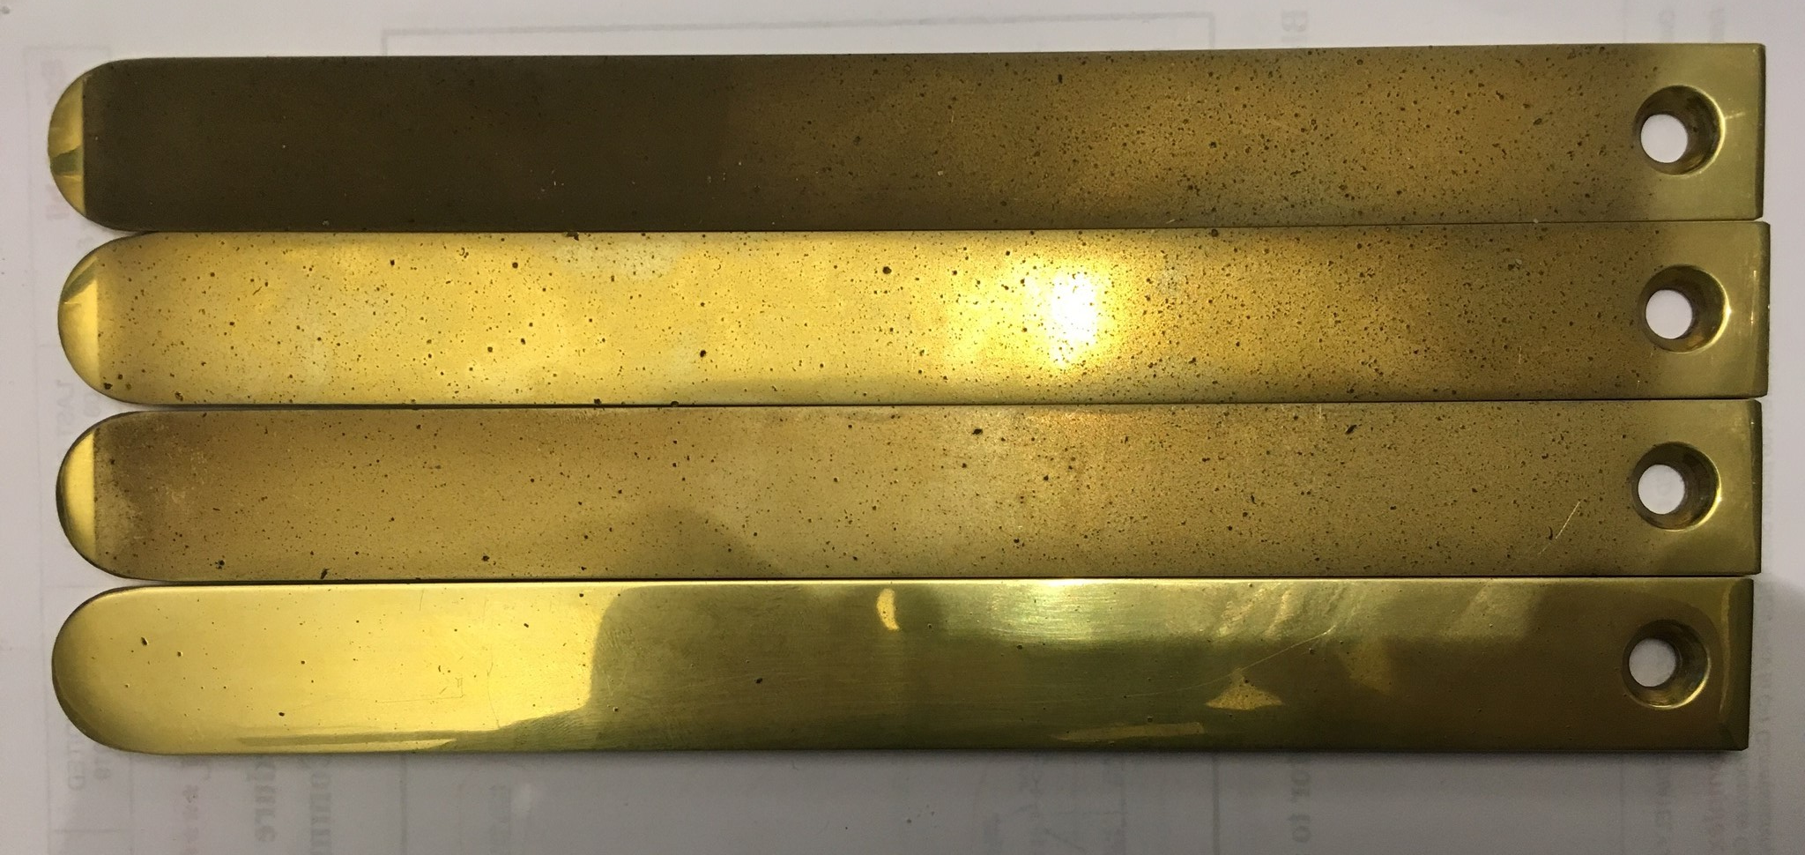
Steam Blowing
A cleaning process wherein steam is generated through operation of a plant boiler system and allowed to pass through steam piping at higher mass flow rates than experienced during normal plant operation in order to remove debris, particulate, and chemical impurities from the system that would otherwise impact on and reduce the lifespan of sensitive downstream components such as rotating equipment.
Apply to the Following Systems:
O&G Petrochem Steam Systems
New Combined Cycle and Utility Plants
Equipment Additions
Tube replacement
Chemical Treatment, Passivation and Steam Purity

Slide 16
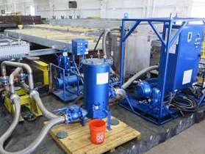
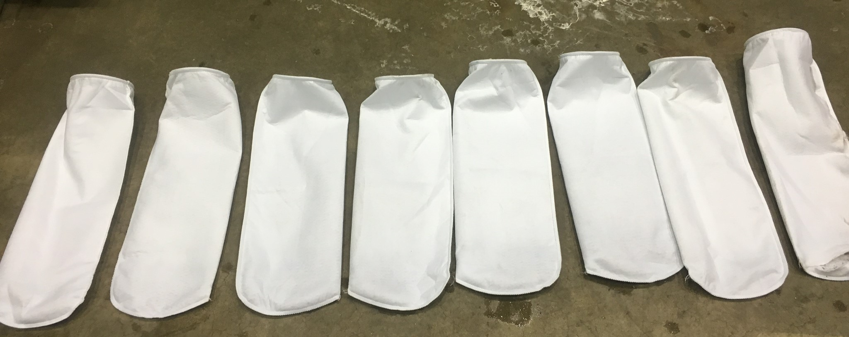
Lube Oil & Hydraulic Oil Flush
Lube oil and hydraulic system flushing for is perform on the oil systems to remove contamination from construction or failure that could impact the operation or reliability of the plant equipment. This is applied to power plant rotating equipment such as gas turbine, steam turbines, and hydraulic valve system. Elden has also performed flushing on hydraulic system for manufacturing equipment and conveyors.
Flushing and maintenance is applied for routine turbine overalls and varnish removal
Apply to the Following Systems:
Steam and gas turbines
Hydraulic control systems
Manufacturing hydraulic systems

Slide 17
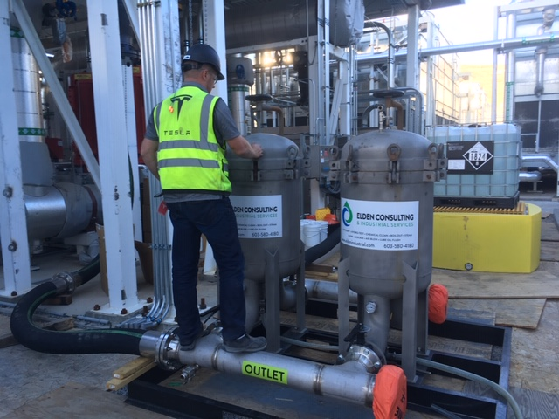
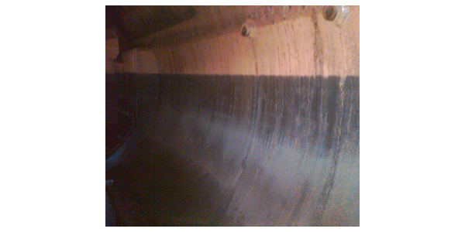
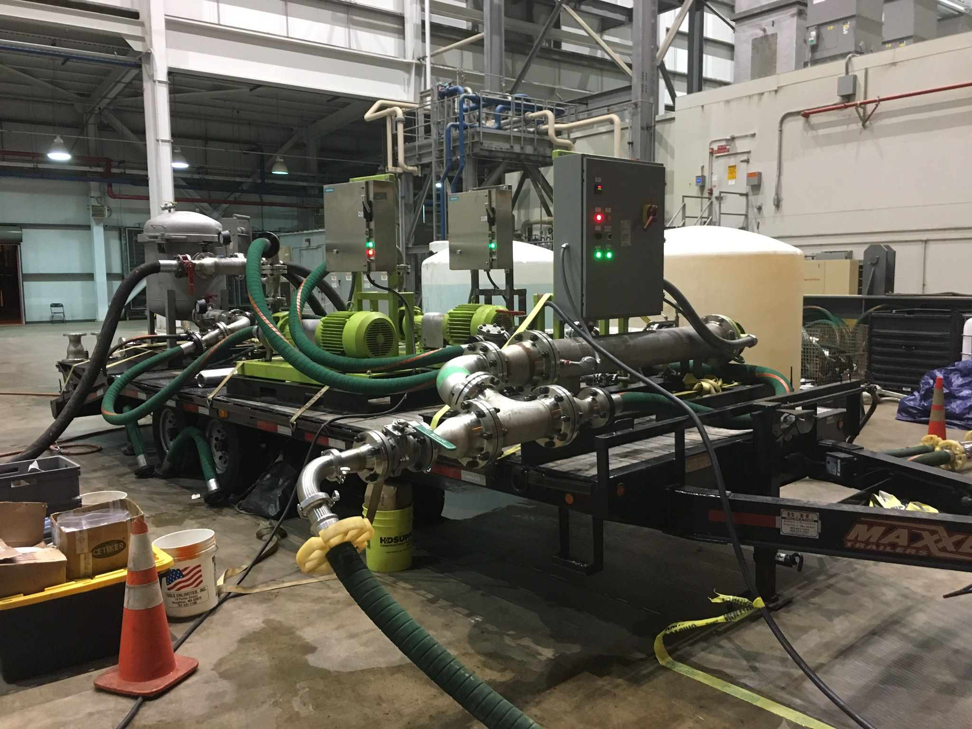
Chemical Clean, Degrease, Boilout
A controlled application of chemically treated water to plant piping and equipment through a circular flow path that allows gradual heating of the fluid and continuous contact of chemicals with system internal metal surfaces. The goal is to dissolve the tightly bonded products, mill scales, grease and oil and other deposits and transport them out of the system. The system will be left with bare base metal and chemically passivated system.
Apply to the Following Systems:
Steam production boilers
Heavily corroded pipe
Process systems with high amounts
of contamination
Decommissioning of fuel oil and gas system
Routine maintenance

Slide 18
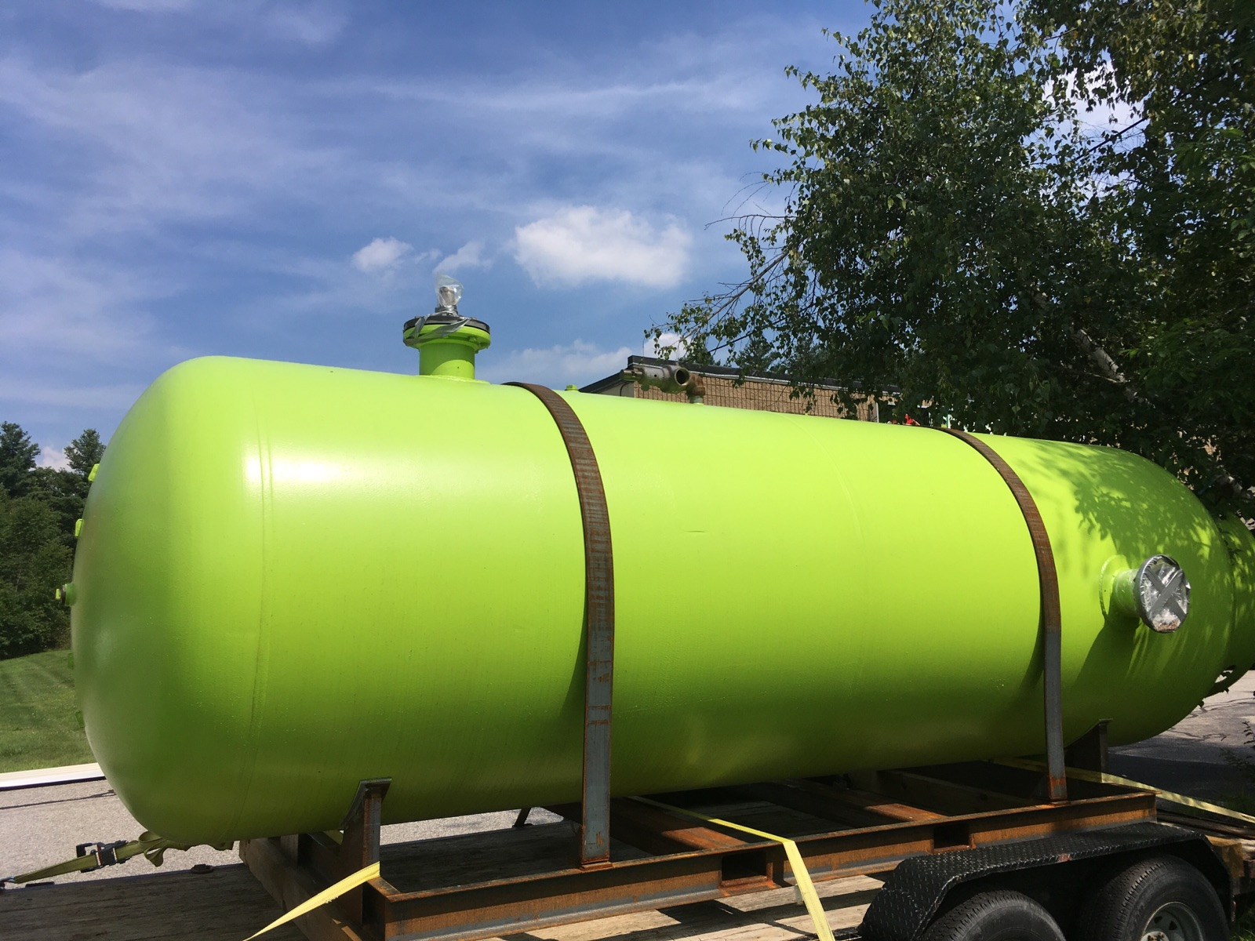
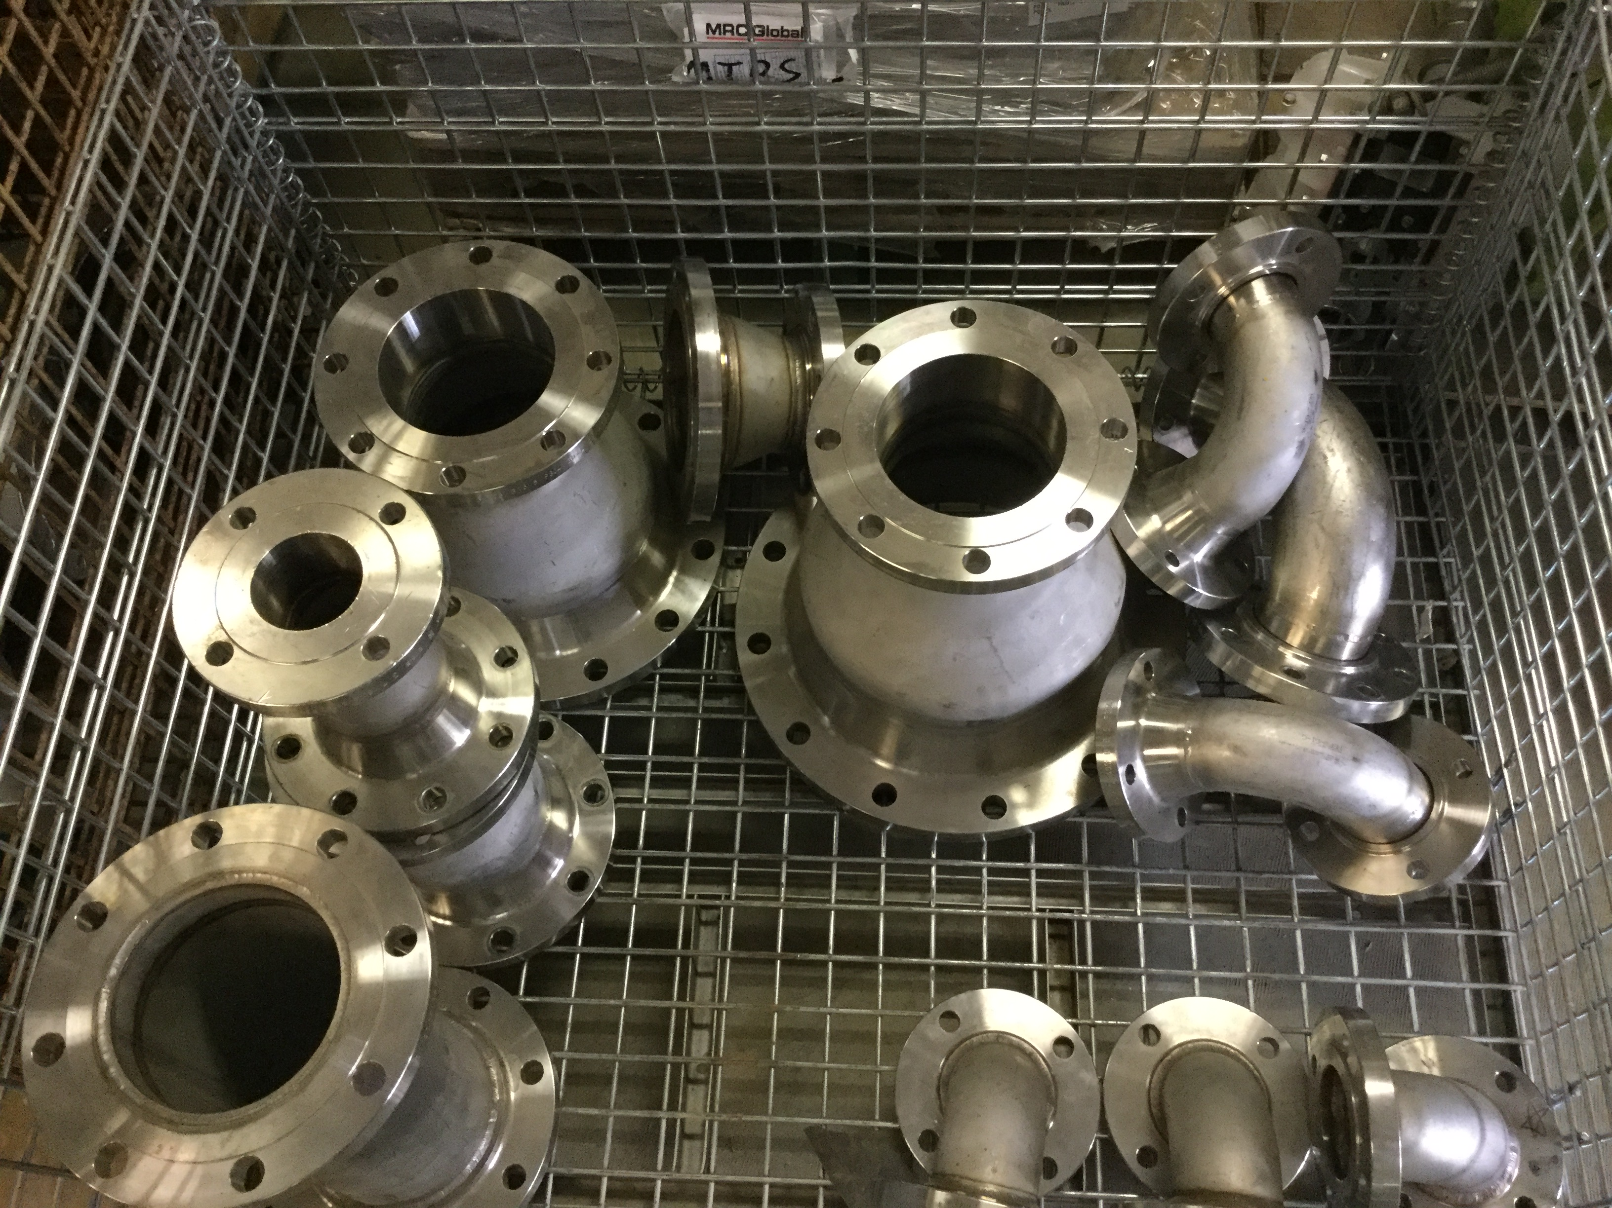
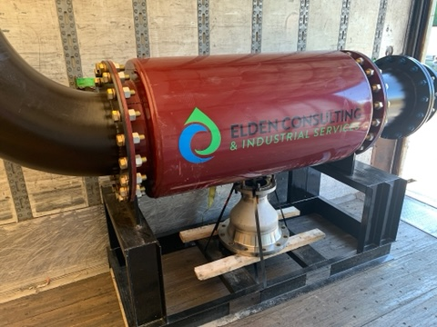
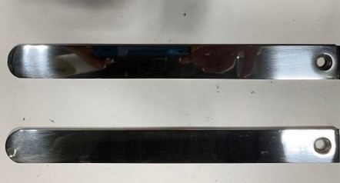
Air Blow
An immediate release of stored compressed air through piping and equipment designed to mobilize loose particulate and construction debris out of plant systems and away from sensitive downstream components.
Elden uses only stainless-steel material for the air blow processes to prevent contamination from temporary equipment.
There are a variety of different sized silencers available to control and not over size.
Apply to the Following Systems:
Steam systems that have been pre cleaned
Fuel gas systems
Air systems and cryogenic

Slide 19
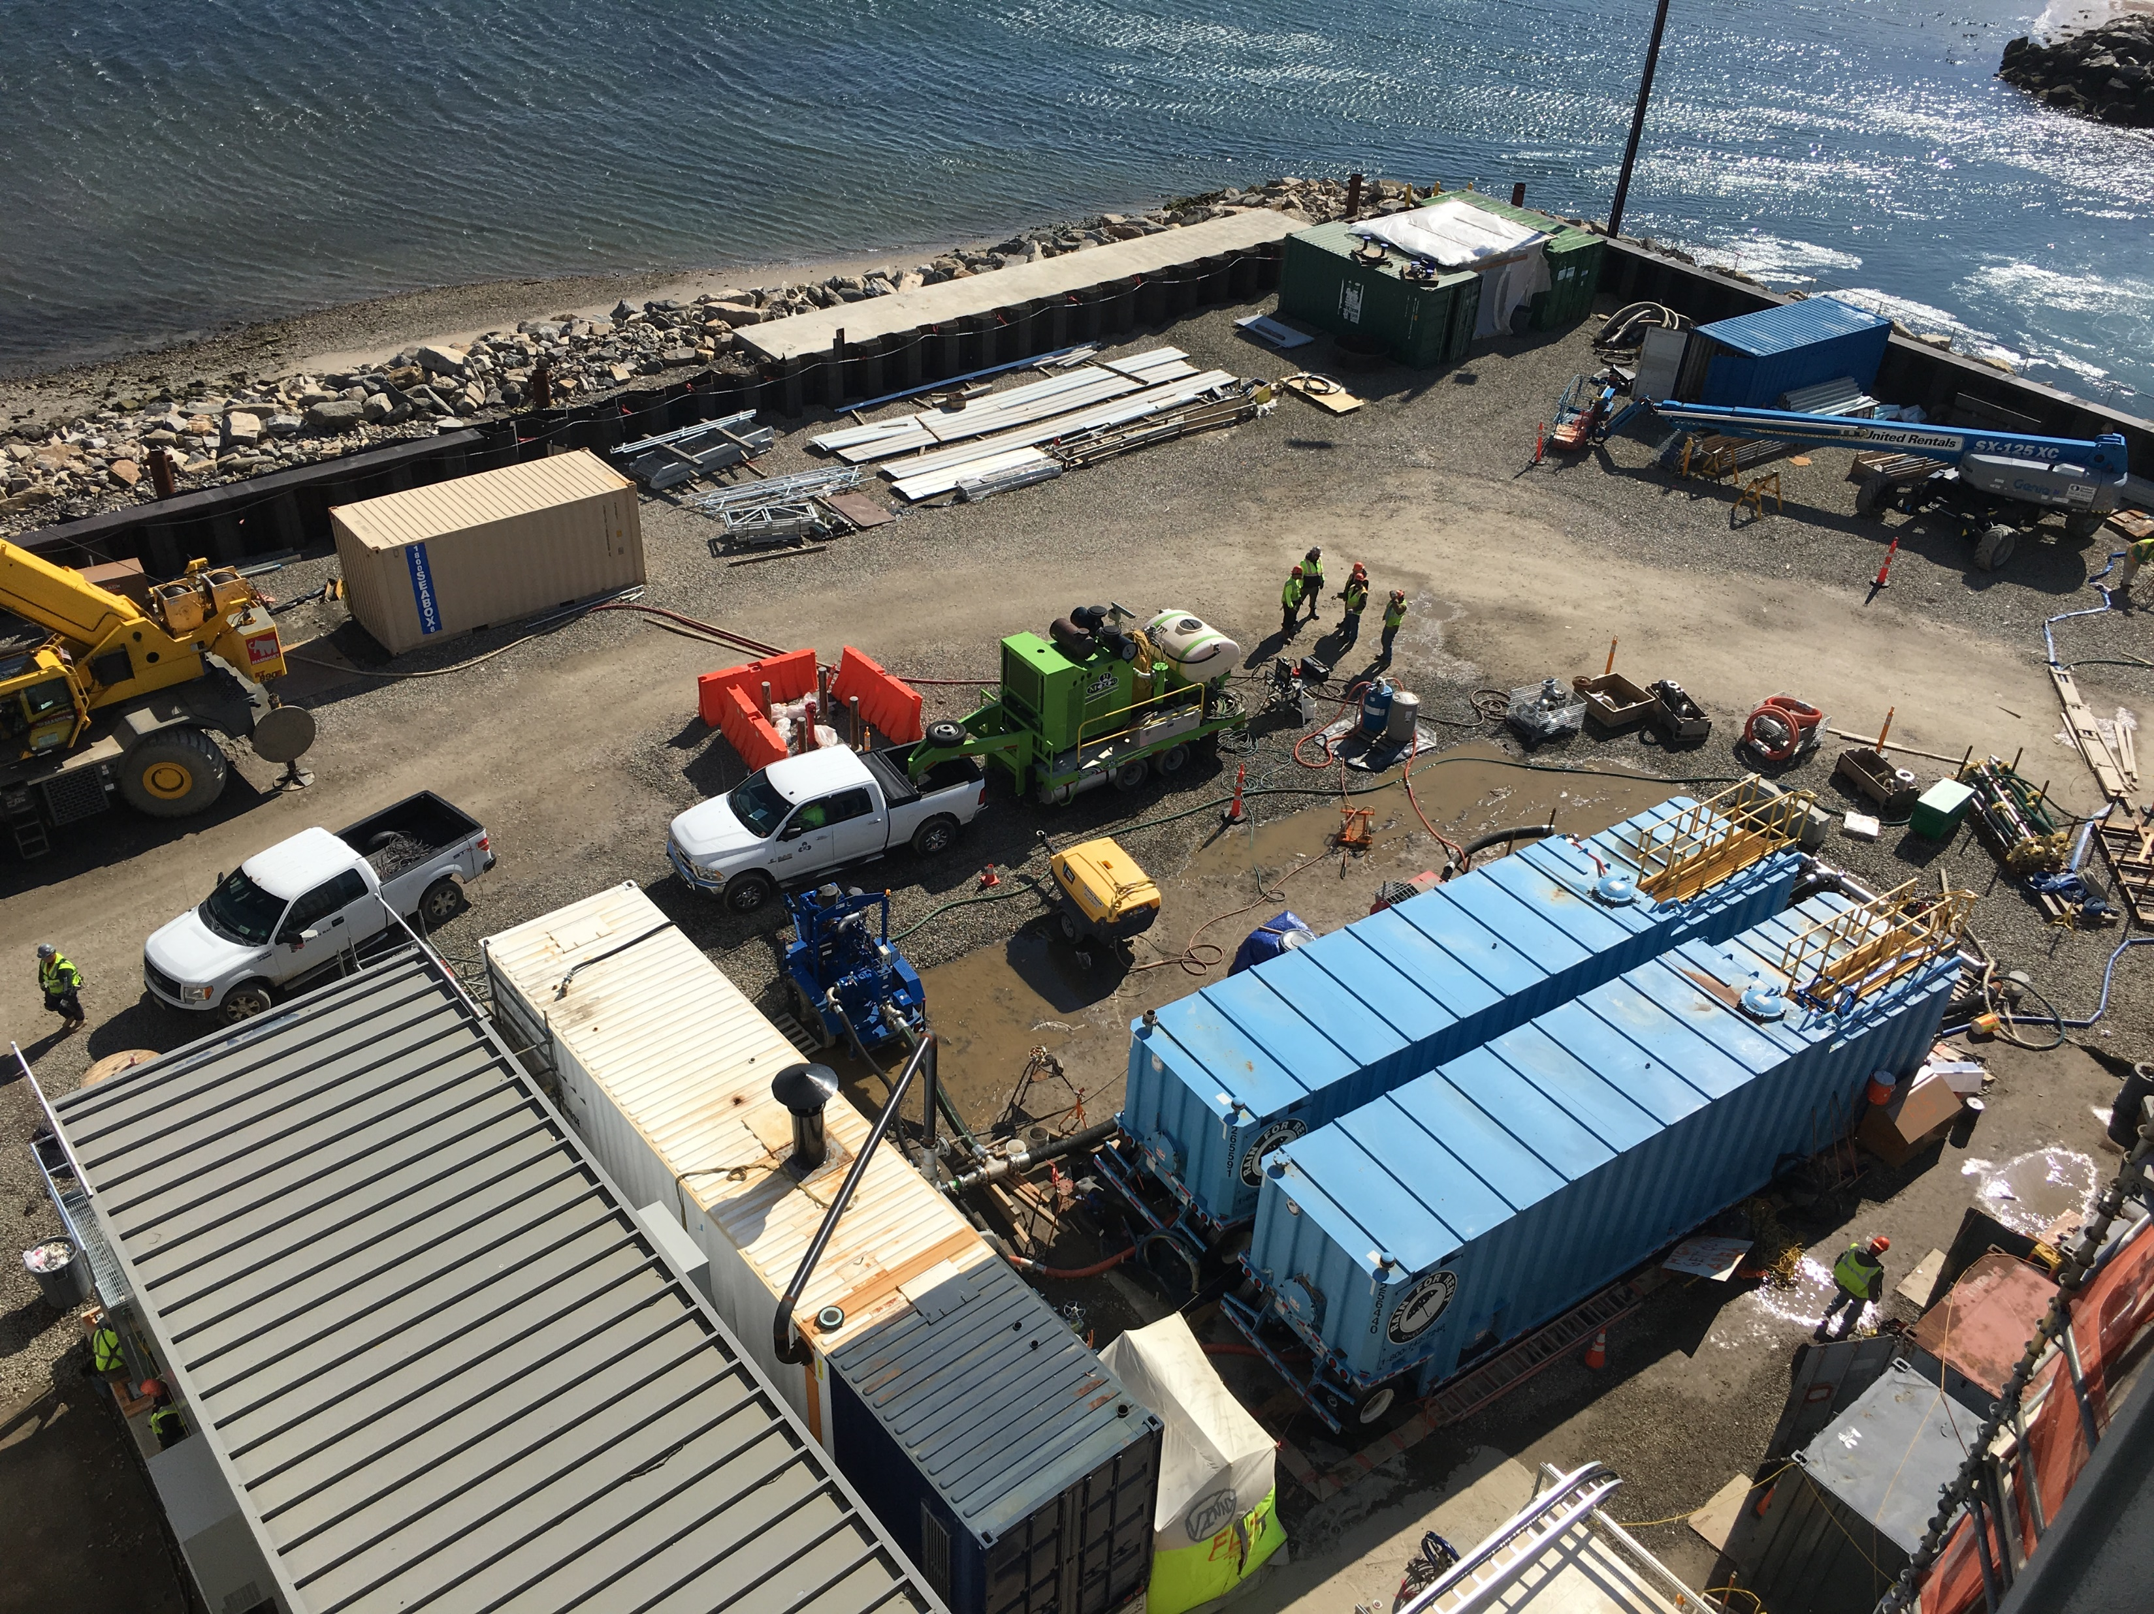
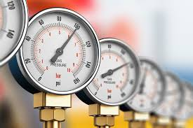
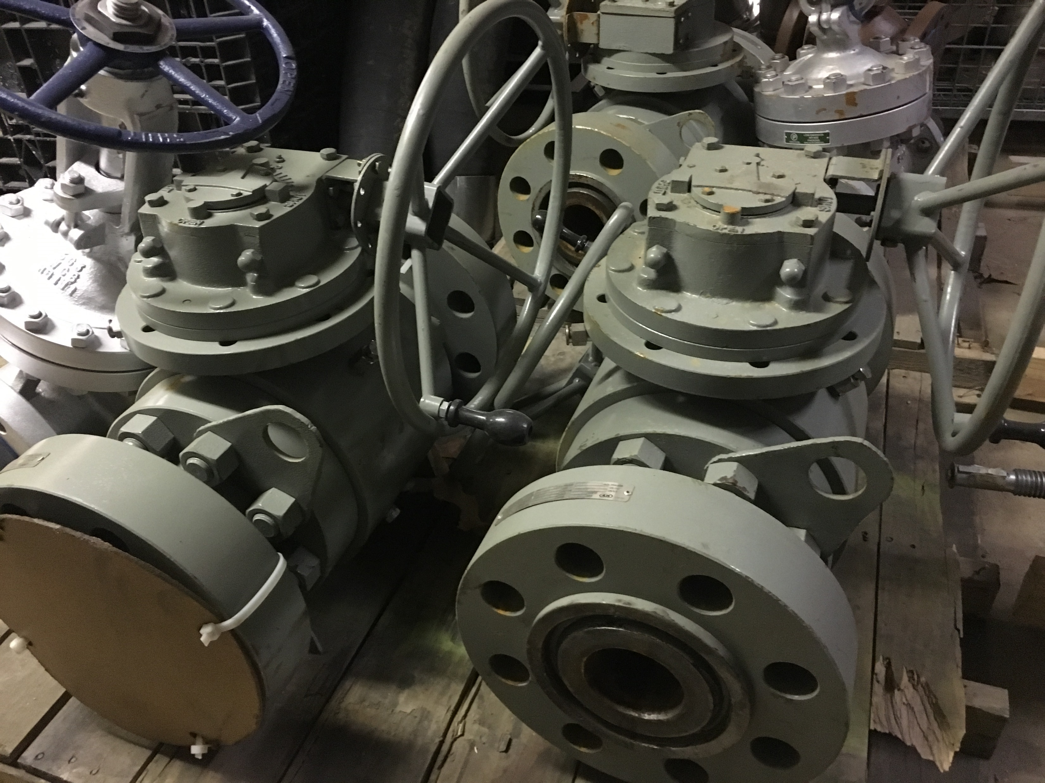
Hydrotesting
A method for qualifying the fabrication integrity of piping and pressure vessels which involves filling a specified system or section of a system with water, increasing the pressure to an established set point, and checking for sources of pressure loss.
Elden uses large bore full pressure valves for isolation on projects. This is to ensure fast filling and draining of the equipment to be tested.
A full engineering procedure is provided.
Apply to the Following Systems:
HRSGs
Boilers
Gas Systems
Water System
New and Modified Systems

Slide 20
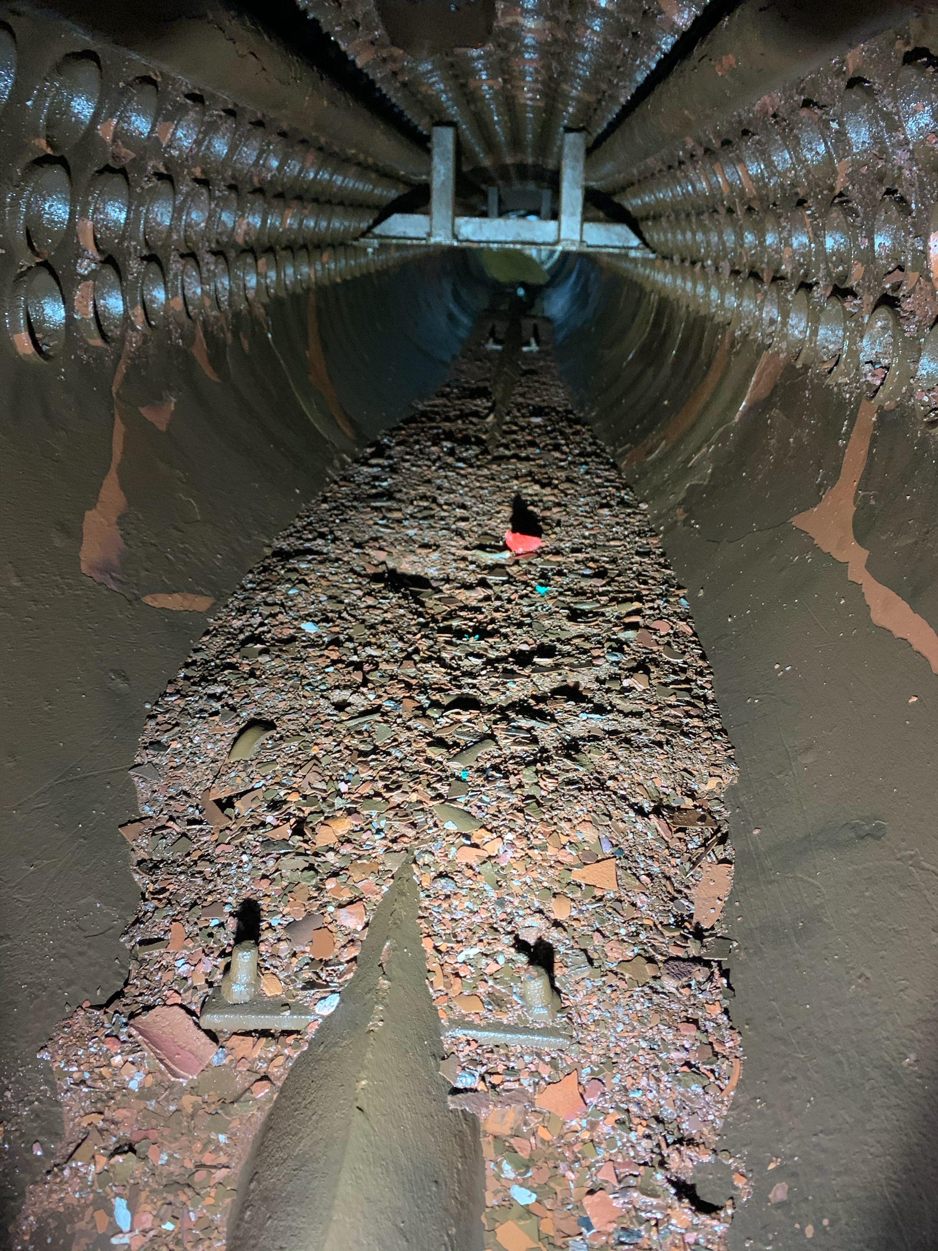
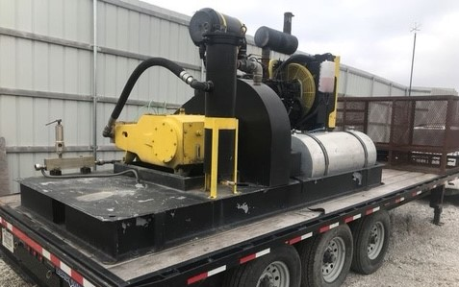
Hydroblasting and Water Jetting
Hydrolazing is high pressure, 40,000psi, rotating hose. The nozzle and hose is rotated on the outside of the pipe to create a cutting action on any mill scale or debris within the pipe. The constant movement of the nozzle prevents the cutting of the base metal. This method is effective at removing any type of hard scale or debris.
Water Jetting is a process that using a rotating nozzle and stationary hose at pressures up to 15,000psi. This process is effective at removing gross debris from piping system and hard scale from boiler tubes.
Apply to the Following Systems:
Steam piping systems
Cooling water
Feedwater
Pump suctions
Boiler tubes
Boilers

Slide 21
PROPOSED SERVICES
Ambient Temperature HRSG Degrease
Ambient degrease operation reduces overall cost by the eliminating the following:
  Temporary boiler rental for heating of the water: $15,000
  Temporary boiler fuel: $3,200
  Temporary boiler union operator: $12,800
  Plant and Elden night shift personnel on staff
    Estimated craft support for night shift duration: $92,000
    Elden personnel and mobilization: $13,400
Execution performed off critical path and offline with only (1) electric pump which reduces risk of delays due to equipment failure

Slide 22
PROPOSED SERVICES
Ambient Temperature HRSG Degrease
Degrease chemical is environmentally friendly and can be sent to plant waste treatment
Typically, only 1 rinse is required

Slide 23
PROPOSED SERVICES
Low Pressure Steam Blow to Atmosphere
The low-pressure steam blow to atmosphere is performed on each HRSG separately and then with both units fired for the combined piping
Steam blow scope includes:
  HRSG 2 and HRSG 3 HP and LP Superheater
  HP and LP BOP piping
  HP and LP bypass piping from the main pipe to the bypass valve
  Seal steam piping
  Auxiliary steam piping to aux boiler and users

Slide 24
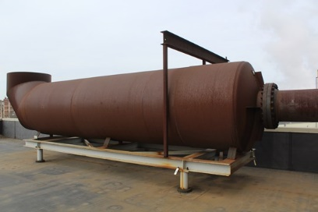
PROPOSED SERVICES
Low Pressure Steam Blow to Atmosphere – Cost Reduction
Elden personnel required is one (1) person per shift
Process is a safer than a high pressure discontinuous or a closed cycle steam blow
GT loads are fired at a lower load but will still maintain a 1.2 CFR or higher
Elden has provided a dry silencer to reduce water and noise
All engineering is provided to B31.1 standards, including stress analysis

Slide 25
PROPOSED SERVICES
Low Pressure Steam Blow to Atmosphere – Additional Serivces
Elden has provided a cost for all temporary piping; flanged and custom welded
Elden has provided a cost for demin trailers and expected usage. Evoqua provides services to BWL and may be able to negotiate a better rate

Slide 26
PROPOSED SERVICES
Low Pressure Steam Blow to Atmosphere – Cost Savings
Table for fuel and water compared to a closed cycle blow

Slide 27
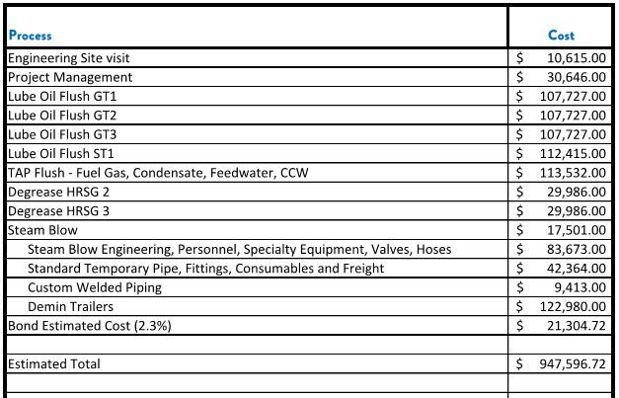
SUMMARY OF COST
Provide a similar table to cover the costs

Slide 28
KEITH STANISEWSKI, PE
Manager of over 25 large scale projects worldwide (Greater than 500,000 USD)
Commissioned combined total 11.2GW of power
Managed up to 40 personnel including contractors.
Commercial responsibility of 16M USD annual gross revenue
Principal Manager
Licensed Professional Engineer in the State of Maine
Consultant and industrial services engineer since 2004.
Wastewater and

Slide 29


Our History
B.S. degree in Civil Engineering from UNH
Licensed Professional Engineer in the State of Maine
Consultant and industrial services engineer since 2004.
Wastewater and drinking water consultant for municipalities
Process engineer for industrial services
Project Manager for industrial services.
Corporate General Manager position responsible for execution of all projects.
Manager of over 25 large scale projects worldwide (Greater than 500,000 USD)
Commissioned combined total 11.2GW of power
Managed up to 40 personnel including contractors.
Commercial responsibility of 16M USD annual gross revenue
KEITH STANISEWSKI, PE
LinkedIn.com: keith-stanisewski
[Principal Manager/Engineer]
Skype: keith_stanisewski

Slide 30
ABOUT THE Team
B.S. degree in Geology from Vanderbilt University
15 years experience in industrial services and fluid process industries.
5 years Project Manager for industrial services.
3 years Business Development for industrial cleaning services
4 years Materials Management for industrial services companies.
Direct involvement in over 25 large scale projects worldwide (Greater than 500,000 USD)
Commissioned combined total 9 GW of power
Leadership of teams of up to 20 project site personnel.
Responsibility of 3M USD global company assets
ALEX
HOLMES
LinkedIn.com: Alexander Holmes
[Principal/Operations]
Skype: holmes_aw9576

